Slide 1
Transaction Management

Slide 2
Transactions
a database request is represented by a single SQL statement
a transaction consists of one or more database requests that, together, represent a logical unit of work to perform some task
a transaction must be completed in its entirety or completely aborted

Slide 3
Consistent Database State
a database is in a consistent state if all data integrity constraints are satisfied
among other things, this means that the data in the database is accurate and unambiguous
a transaction moves a database from one consistent state to another

Slide 4
Example
the next slide is for a small database consisting of four tables and storing school enrollment data for the current semester
for simplicity, we will assume all courses are three credit hours

Slide 5
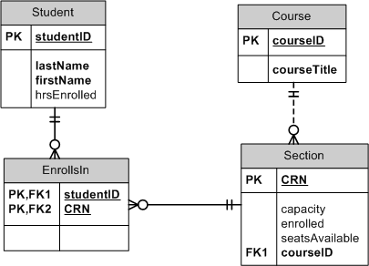
School Database

Slide 6
Transaction Example
suppose we want to insert a record into the EnrollsIn table
this will require several SQL statements since the attributes seatsAvailable and enrolled in Section and the attribute hrsEnrolled in Student must also be updated

Slide 7
Transaction Example
INSERT INTO EnrollsIn
VALUES('002', '987654');
UPDATE Section
SET enrolled = enrolled + 1
WHERE CRN = '987654';
UPDATE Section
SET seatsAvailable = seatsAvailable -1
WHERE CRN = '987654';
UPDATE Student
SET hrsEnrolled = hrsEnrolled + 3
WHERE studentID = '002';

Slide 8
Transaction Results
as a result of this transaction,
one row will be added to EnrollsIn
a row in Section will be modified (the value of two fields will be changed)
a row in Student will be modified
clearly, it is important that either all of these changes be made or none of these changes be made

Slide 9
The ACID Test
each transaction must pass the ACID test by satisfying these four properties
Atomicity: all operations of the transaction must be completed
Consistency: the result of the transaction must leave the database in a consistent state

Slide 10
The ACID Test
Isolation: data used during a transaction must be isolated from other transactions that require the same data – no other transaction can use the data until the first transaction is completed
Durability: once the transaction is completed (committed), the changes are permanent, even in the case of system failure

Slide 11
Serializability
in addition to passing the ACID test, transactions in multi-user databases must be serializable
this means that if two transactions are being executed at the same time, the result must be the same as if they were executed one after the other

Slide 12
Transactions with SQL
SQL provides two statements to help with transaction management
COMMIT: this statement signals the end of a transaction and causes all changes to be permanently recorded in the database
ROLLBACK: this statement causes all changes made since the last COMMIT statement to be aborted, so the database is rolled back to a previous consistent state

Slide 13
Transaction Logs
a transaction log keeps track of all the changes in the database
suppose we have the transaction shown on the following slide
note: this transaction refers to tables in Chapter 10 of your text, on page 490

Slide 14
Sample Transaction
UPDATE PRODUCT
SET PROD_QOH = PROD_QOH – 2
WHERE PROD_CODE = ‘1558-QWI’;
UPDATE CUSTOMER
SET CUST_BALANCE = CUST_BALANCE + 89.98
where CUST_NUMBER = ‘10011’;
COMMIT;

Slide 15
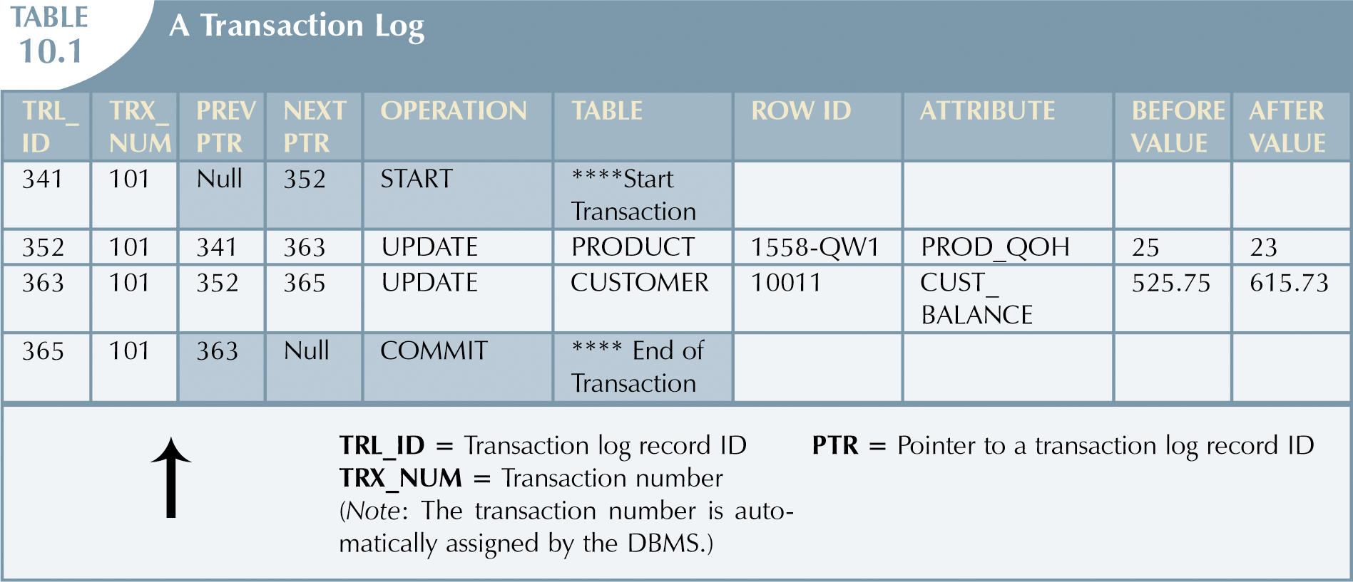
Sample Transaction Log

Slide 16
Uses of Transaction Logs
the transaction log is a vital element of a transaction DBMS
it is used to restore the database to a consistent state; in the event of a database failure
roll back uncommitted transactions
roll forward transactions that were committed but not yet physically written to the physical database

Slide 17
Concurrency Controls
multiuser systems must ensure the serializability of all transactions
problems may occur because of
lost updates
uncommitted data
inconsistent retrievals

Slide 18
Lost Updates
updates may be lost if two transactions are updating the same data element and one transaction overwrites the result of the other transaction

Slide 19
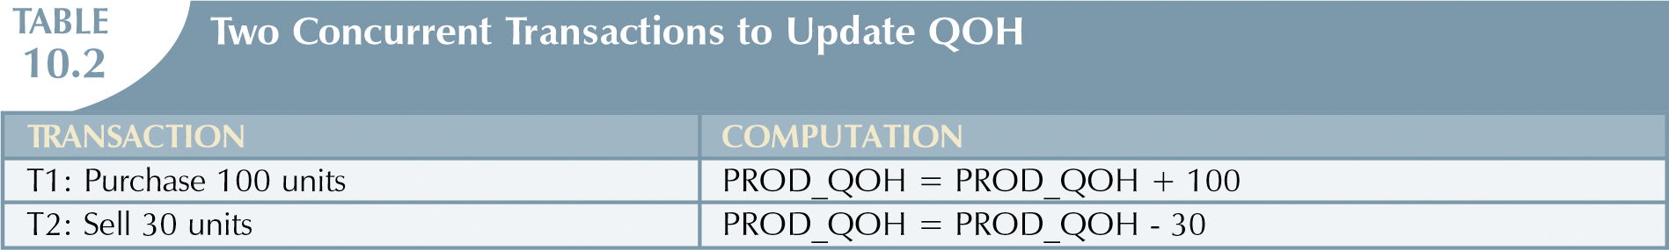
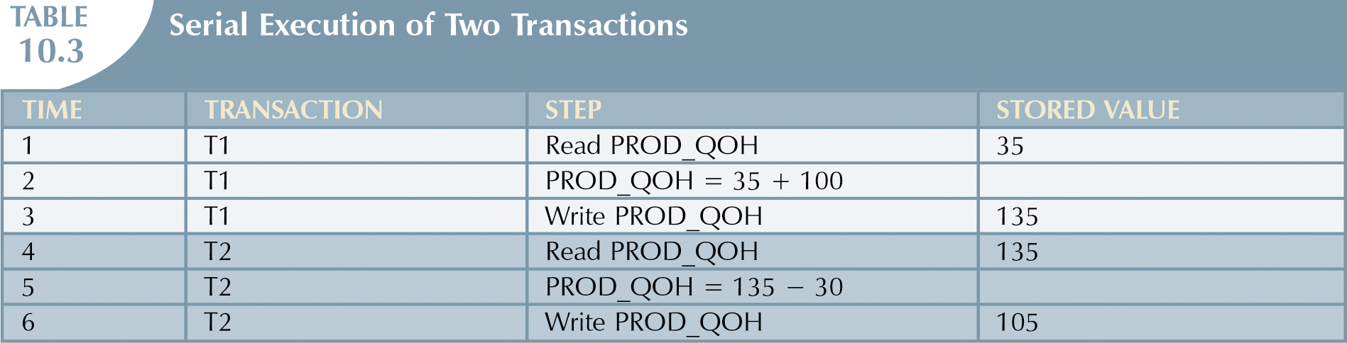
Example: Lost Updates

Slide 20
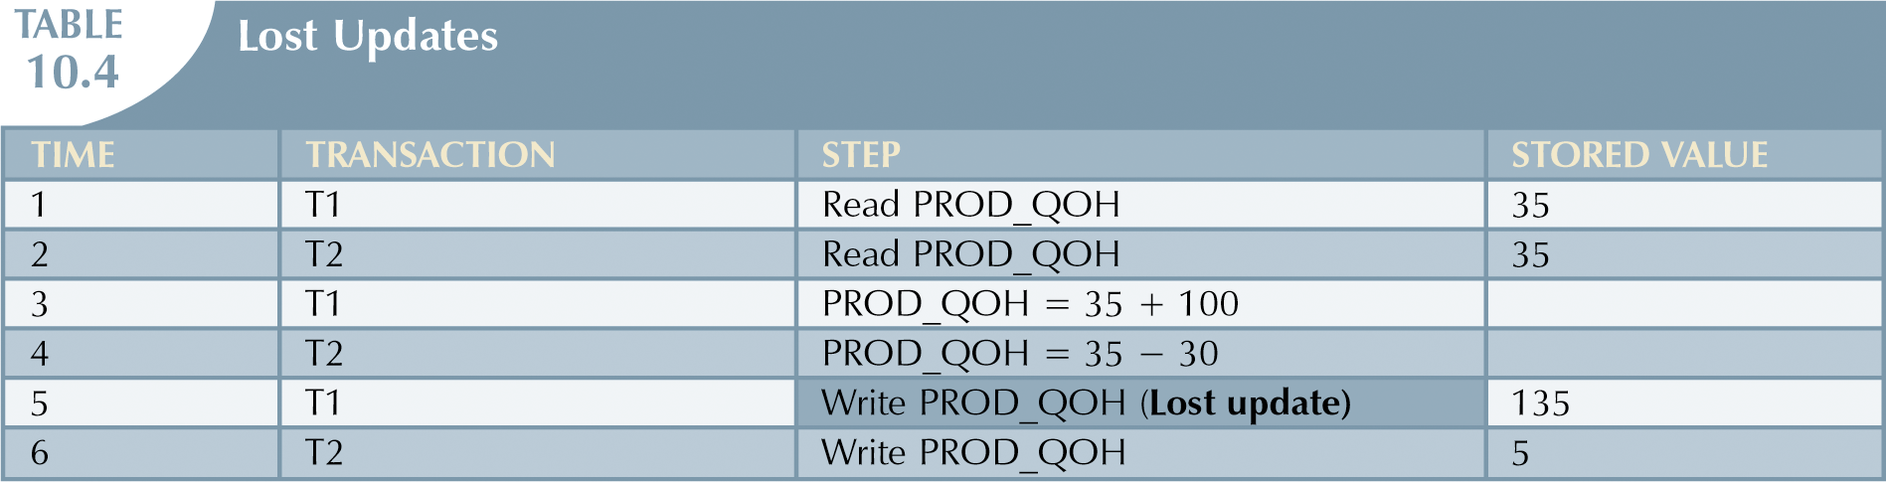
Example: Lost Updates

Slide 21
Uncommitted Data
the problem of uncommitted data occurs when two transactions T1 and T2 are executing concurrently
T1 writes some data to the database
T2 uses the data that T1 has written to the database
T1 rolls back the transaction involving the changes

Slide 22
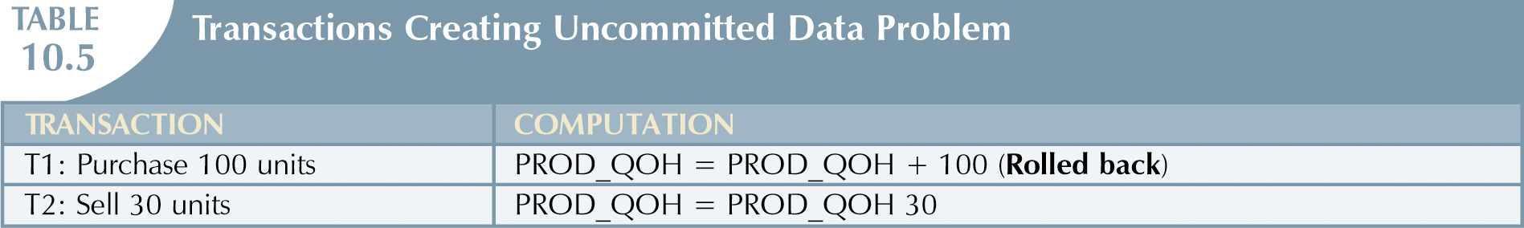
Example: Uncommitted Data
Correct Execution of Two Transactions
Time | Transactions | Step | Stored Value
1 | T1 | Read PROD_QOH | 35
2 | T1 | PROD_QOH = 35 + 100
3 | T1 | Write PROD_QOH | 135
4 | T1 | *****ROLLBACK***** | 35
5 | T2 | Read PROD_QOH | 35
6 | T2 | PROD_QOH = 35 – 30
7 | T2 | Write PROD_QOH | 5

Slide 23
Example: Uncommitted Data
Uncommitted Data Problem
Time | Transactions | Step | Stored Value
1 | T1 | Read PROD_QOH | 35
2 | T1 | PROD_QOH = 35 + 100
3 | T1 | Write PROD_QOH | 135
4 | T2 | Read PROD_QOH (read uncommitted data) | 135
5 | T2 | PROD_QOH = 135 – 30
6 | T1 | *****ROLLBACK***** | 35
7 | T2 | Write PROD_QOH | 105

Slide 24
Inconsistent Retrievals
the problem of inconsistent retrievals occurs when a transaction is processing a collection of data that another transaction is updating
the first transaction accesses some of the data before the second transaction has completed the update and accesses other parts of the data after the second transaction has completed the update

Slide 25
Example: Inconsistent Retrieval
T1 is attempting to calculate the total of quantity on hand for all items in the Product table
T2 is updating the quantity on hand for two of the products in the Product table

Slide 26
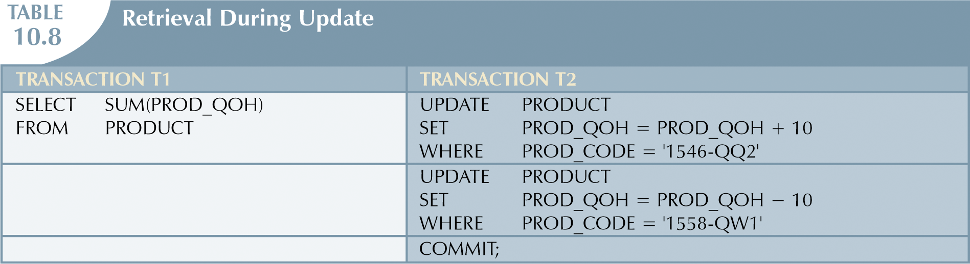
Example: Inconsistent Retrieval

Slide 27
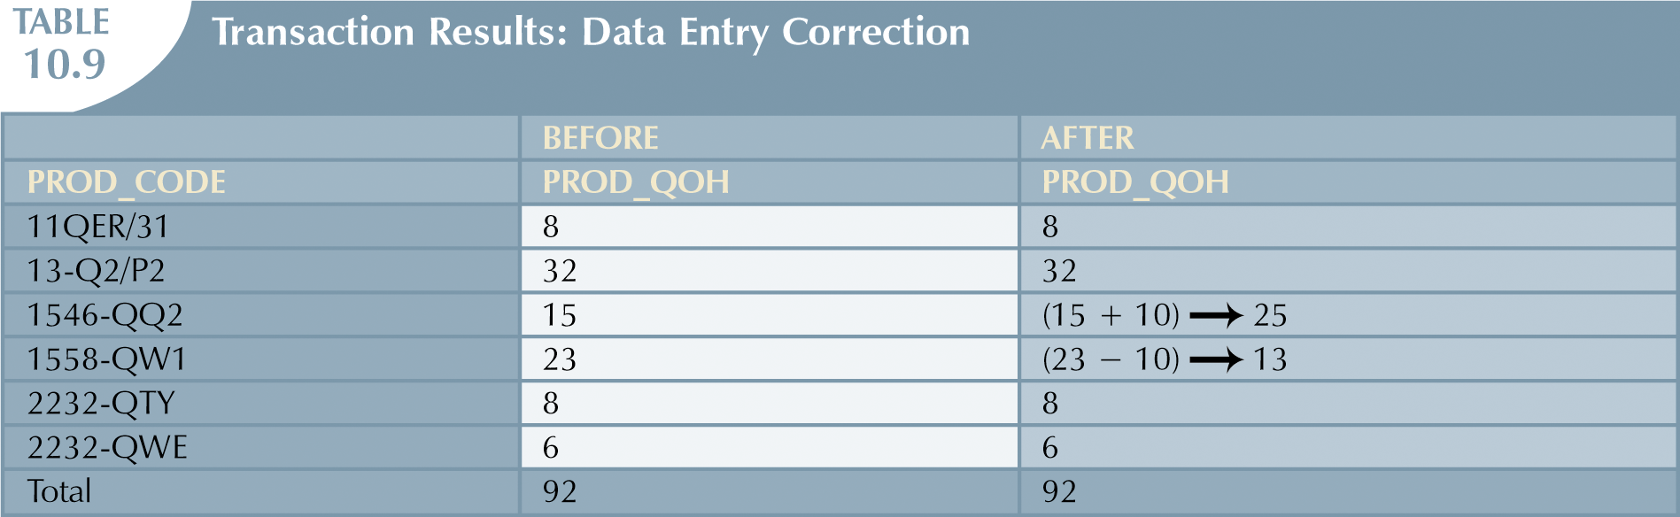
Example: Inconsistent Retrieval

Slide 28
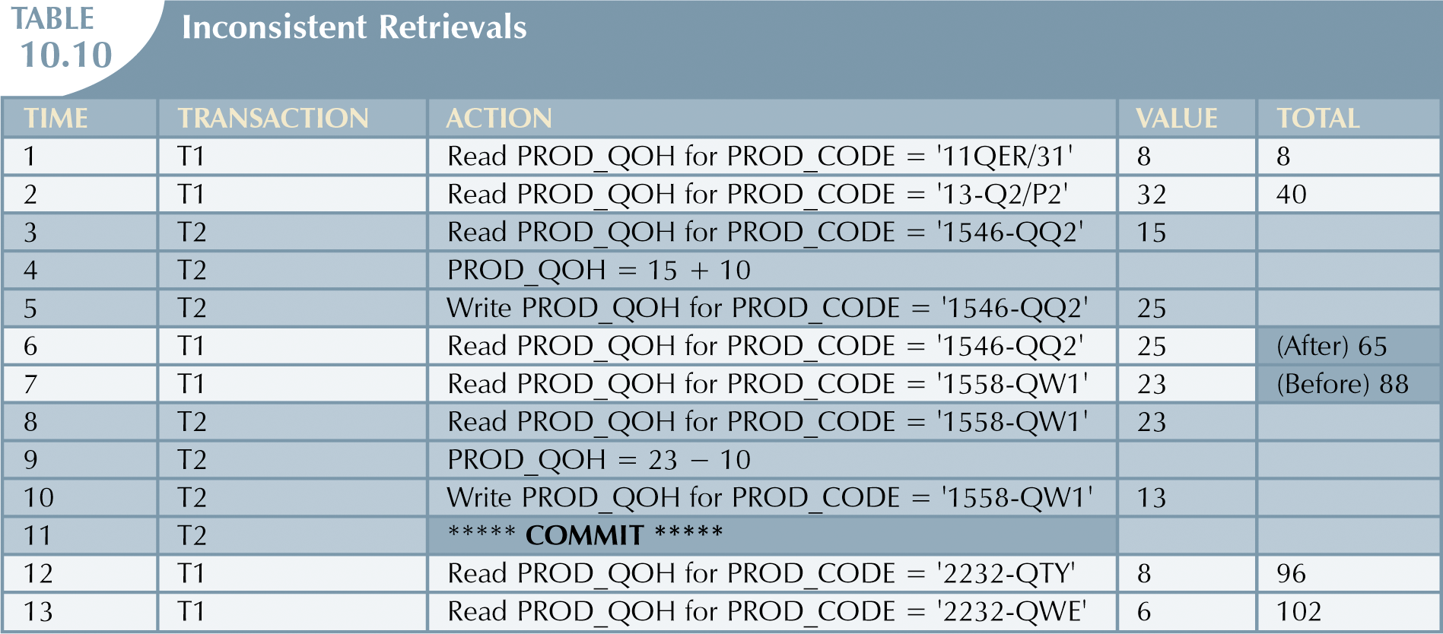
Example: Inconsistent Retrieval

Slide 29
What to Do?
to prevent these problems, there are several different types of concurrency controls
we will look at two such controls
locks
time stamping

Slide 30
Locks
locking is one of the most frequently used methods for handling some of the problems arising from concurrent users

Slide 31
Lock Granularity
the level of locking, called lock granularity, may be at the
database level
table level
page level
row level
field level

Slide 32
Lock Types
lock types include
binary locks: has only two states – locked or unlocked
shared/exclusive locks
an exclusive lock must be used by a transaction that wants to write to an object; with an exclusive lock, no other transaction can access the object
a shared lock can be used by all transactions that want read-only access

Slide 33
Two-Phase Locking
two-phase locking describes a method for acquiring and releasing locks
growing phase: locks are acquired but none are released
once all locks are acquired, the transaction is in its locked point
no data are affected until the transaction is in its locked point
shrinking phase: locks are released, and no new locks can be acquired

Slide 34
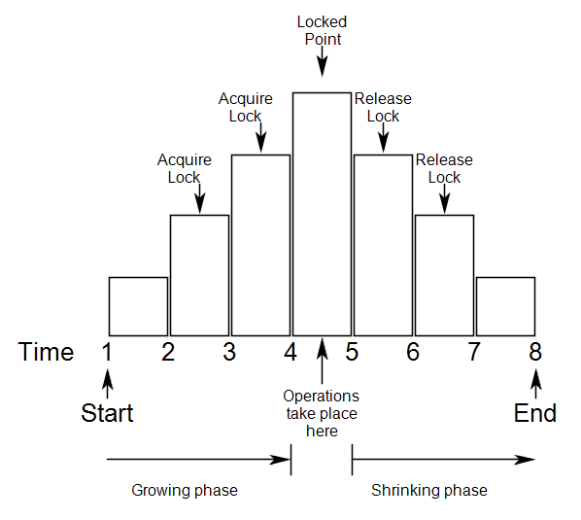
Two-Phase Locking

Slide 35
Two-Phase Locking
when two-phase locking is used, no transaction can affect any data until all locks are obtained
two-phase locking
guarantees serializability
does not prevent deadlock

Slide 36
Two-Phase Locking
deadlocks may occur if two transactions are acquiring locks and each needs a record locked by the other

Slide 37
Handling Deadlock
methods for handling deadlock
deadlock detection – test for deadlocks periodically and abort one of the transactions
deadlock prevention/avoidance
abort a transaction if it requests a lock that could create deadlock
require that locks be acquired in a specified order; no data can be altered until all locks are obtained
method for deadlock avoidance: timestamping

Slide 38
Time Stamping
time stamping requires that each transaction be assigned a time stamp
time stamps are guaranteed to be unique and to always increase in value
based on the relative value of the timestamps of two transactions, a transaction may be allowed to wait for locks to be released, or may be rolled back and re-scheduled

Slide 39
Example: Wait/Die
assume ts(T1) < ts(T2) (so T1 is the older transaction)
assume T1 requests a lock that T2 holds
T1 waits until T2 is completed and the locks are released
then T1 can proceed
assume T2 requests a lock that T1 holds
T2 dies (rolls back)
T2 is re-scheduled, with the same time stamp

Slide 40
Time Stamping
with wait/die, the older transaction waits, so we cannot have a wait cycle:
T1 waits on T2 waits on T3 waits on T1
for this to occur, T1 must be older than T2 which must be older than T3, which must be older than T1 – impossible

Slide 41
Time Stamping
time stamping also prevents starvation
starvation occurs when a transaction waits forever
with time stamping, transactions are rescheduled using the same time stamp, thus guaranteeing that they will grow older

Slide 42
Transaction Recovery
recovery procedures may vary depending on whether transactions are written to the database using deferred-write (deferred update) or write-through (immediate update)

Slide 43
Deferred Updates
transactions are not immediately updated in the physical database
only the transaction log is updated
the physical database is updated after the commit point
data is stored in buffers and is written to the database at database checkpoints ; checkpoints are automatically scheduled several times per hour

Slide 44
Write-Through Updates
with write-through updates, the database is immediately updated by each operation in the transaction, even before the commit point is reached

Slide 45
Transaction Recovery
in case of a database failure, the first steps of the recovery process are the same for either deferred updates or write-through updates
identify the latest checkpoint
for transactions started and committed before the last checkpoint, do nothing
for transactions committed after the last checkpoint, use the after values in the transaction log to redo the transaction

Slide 46
Transaction Recovery
for any transaction that had a rollback or was active after the last checkpoint
for deferred updates, do nothing – with deferred updates, the database was never updated
for write-through updates, undo the operations using the before values in the transaction logs

Slide 47
Transaction Management
The End

